Slide 2
What’s new in ASP.NET Core?
Daniel Roth
Microsoft

Slide 3
ASP.NET Core 2.2
Preview 2

Slide 4
Get started with ASP.NET Core 2.2 Preview 2
Install the .NET Core 2.2 Preview 2 SDK
https://www.microsoft.com/net/download/dotnet-core/2.2
Install Visual Studio 2017 15.9 Preview 2
https://visualstudio.com/preview/

Slide 5
Get started with ASP.NET Core 2.2 Preview 2

Slide 6
ASP.NET Core 2.2 features
Template updates: Bootstrap 4, Angular 6
Web API improvements
HTTP/2
IIS in-process hosting
Health checks
Endpoint routing
SignalR Java client

Slide 7




APIs are everywhere!
APIs
APIs
APIs
APIs

Slide 8
Web API improvements in ASP.NET Core 2.2
Easier to create
Easier to test & debug
Easier to document
Easier to consume
Easier to secure
Easier to monitor
Improved performance

Slide 9
Web API improvements

Slide 10
Web API improvements in ASP.NET Core 2.2
Easier to create
Easier to test & debug
Easier to document
Easier to consume
Easier to secure
Easier to monitor
Improved performance
→ API Scaffolding
→ HTTP REPL, Problem Details
→ API conventions & analyzer
→ Code generation (Preview 3)
→ Web API security (Preview 3)
→ Health checks integration
→ HTTP/2, endpoint routing, IIS in-proc hosting

Slide 11
HTTP/2
Now available cross-platform in Kestrel
Application-Layer Protocol Negotiation (ALPN)
Header compression
Multiplexed streams over same connection
Some limitations
Server push, stream prioritization not currently supported
Not supported for edge use at this time

Slide 12
HTTP/2

Slide 13
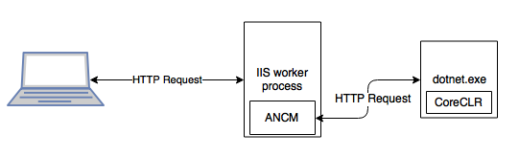
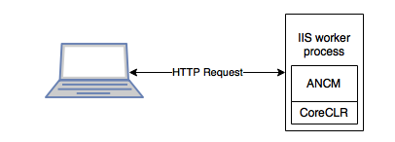
IIS in-process hosting
Out of process (current)
In process (NEW!)

Slide 14
IIS in-process hosting
Improved performance, reliability, and diagnostics

Slide 15
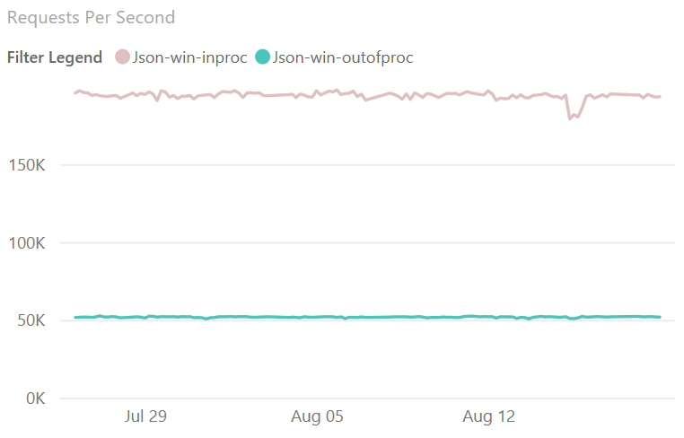
IIS in-process hosting – Performance!
4x
faster!

Slide 16
IIS in-process hosting

Slide 17
Health checks
Add dedicated health endpoints to your application
Integrate with container orchestrators and load balancers
Support liveness and readiness probes

Slide 18
Health checks

Slide 19
Endpoint routing
New routing implementation
On by default for 2.2 with compatibility switches
Better throughput (~10%) and scalability
Link to endpoints from outside of MVC
Various minor improvements
Parameter transformers, new catch all syntax {**path}

Slide 20
SignalR Java client
Connect to ASP.NET Core SignalR hubs in Java
Available via Gradle and Maven
Now supports Azure SignalR Service
Complete Android sample
https://github.com/aspnet/SignalR-samples/tree/master/AndroidJavaClient

Slide 21
SignalR Android client

Slide 22
ASP.NET Core 2.2 features
Template updates: Bootstrap 4, Angular 6
Web API improvements
HTTP/2
IIS in-process hosting
Health checks
Endpoint routing
SignalR Java client

Slide 23
ASP.NET Core 2.2 schedule
Preview 2 - Sept
Preview 3 – Oct
RTW – Year-end 2018

Slide 24
Install the .NET Core 2.2 Preview 2 SDK
https://www.microsoft.com/net/download/dotnet-core/2.2

